Slide 1

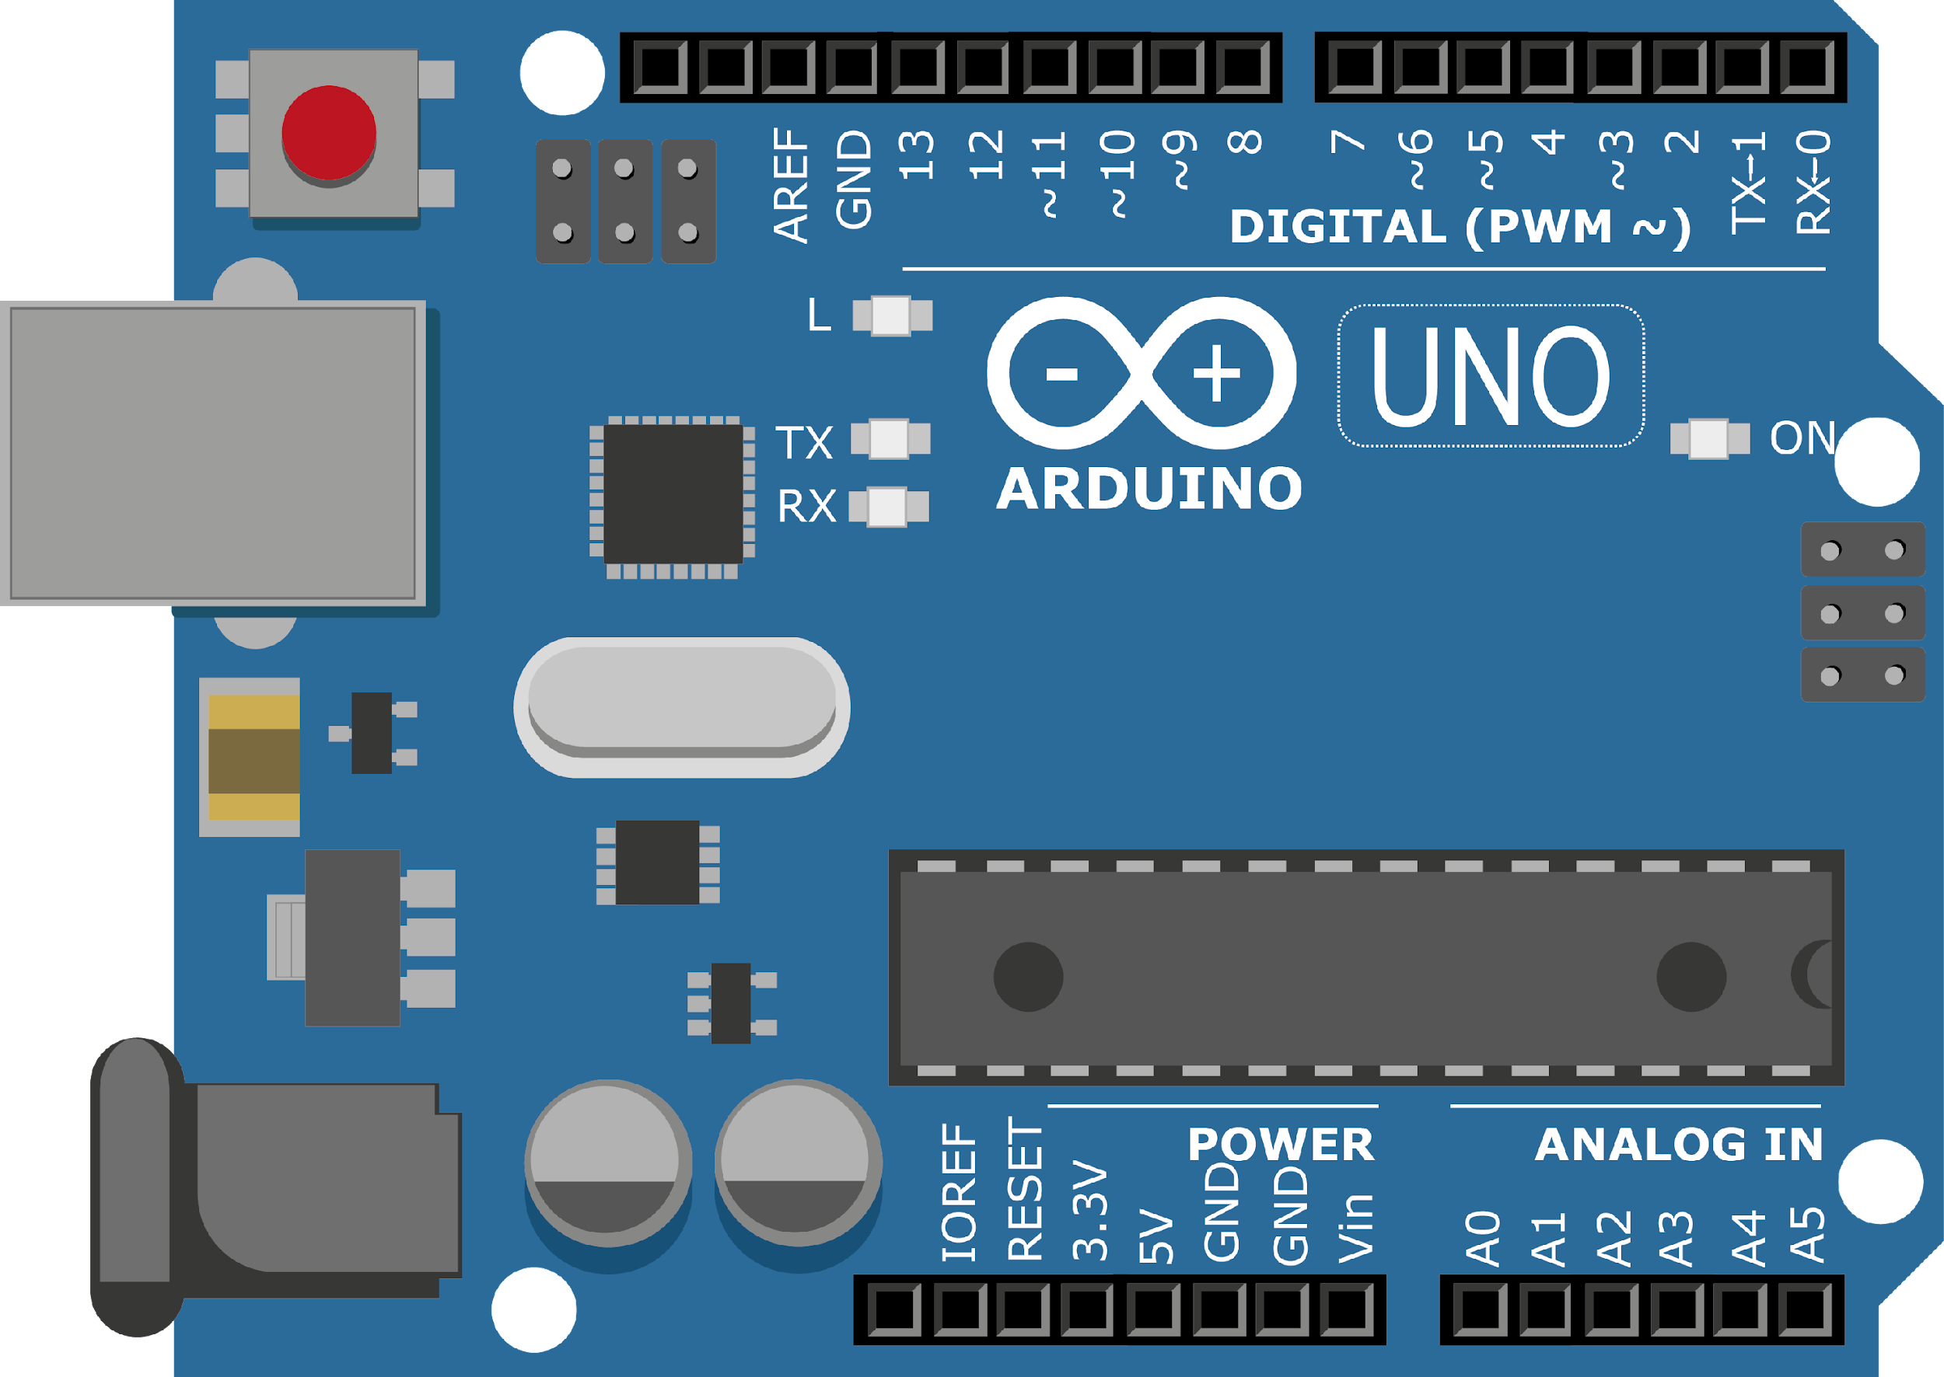
ARDUINO MASTER CLASS
20
Water flow detection using Flow sensor

Slide 2
20 AGENDA
02
03
01
Measuring water flow
Water Flow sensor
Interview questions &Tech News

Slide 3
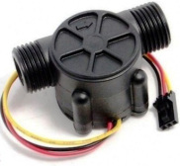
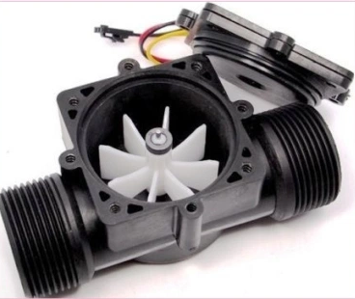
YF-S201 Hall-Effect Water flow sensor
This sensor sits in line with the water line and contains a pinwheel sensor to measure how much water has moved through it. There is an integrated magnetic Hall-Effect sensor that outputs an electrical pulse with every revolution.
The “YFS201 Hall Effect Water Flow Sensor” comes with three wires: Red/VCC (5-24V DC Input), Black/GND (0V) and Yellow/OUT (Pulse Output). By counting the pulses from the output of the sensor, we can easily calculate the water flow rate (in litre/hour – L/hr) using a suitable conversion formula.

Slide 4
Flow rate determination
The basis relationship for determining the liquid’s flow rate in such cases is Q=VxA,
Q - flow rate/total flow of water through the pipe
V - average velocity of the flow and A is the cross-sectional area of the pipe
Pulse frequency (Hz) = 7.5Q, Q is flow rate in Litres/minute – in Minute
Flow Rate (Litres/hour) = (Pulse frequency x 60 min) / 7.5Q – Q in hour
Pulses=7.5×Q
Q=Pulses/7.5 (This is flow rate in Litres/min)
Q=Pulses/(7.5×60) (This is flow rate in Litres/hour

Slide 5
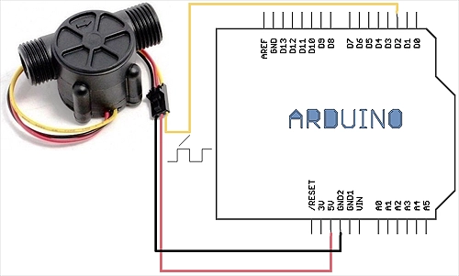
Water flow detection with Arduino

Slide 6

INTERVIEW QUESTIONS
CDMA, TDMA, FDMA
Examples of negative feedback and positive feedback
Instrumentation Amplifier
Code division multiple access (CDMA) | time division multiple access (TDMA) | frequency-division multiple access (FDMA)
-ve feedback is Amplifiers And for +ve feedback is Oscillators
An instrumentation amplifier is a differential op-amp circuit providing high input impedances with ease of gain adjustment by varying a single resistor.

Slide 7

THANKS!

